Slide 1
Data Breaches in India
By: Aman Patel

Slide 2
Introduction
A data breach is a cyber attack in which sensitive, confidential or otherwise protected data has been accessed or disclosed in an unauthorized fashion.
Data breaches can occur in any size and organization, from small businesses to major corporations.
There are various sectors which are targeted by cyber attacks, such as Web, Government, Healthcare, Financial etc..
The dataset, used here to perform visualization is from kaggle, which has more than than 30000 records, between year 2004 and 2017 and has has 270 observations and 11 variables.

Slide 3


Why?
The main reason to choose Data breach as topic is to spread awareness, as there are lots of people and organizations, getting trapped by cyber attacks.
The approach here is to analyze the sectors which faced most number of data breaches, whereas years with the highest number of data breach.
The visualizations performed on the data can lead the to public awareness, and they might be able to keep their data secure.

Slide 4
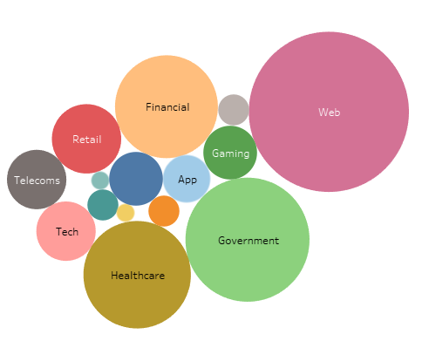
Sectors with most number of record leaked between year 2004-2017.

Slide 5
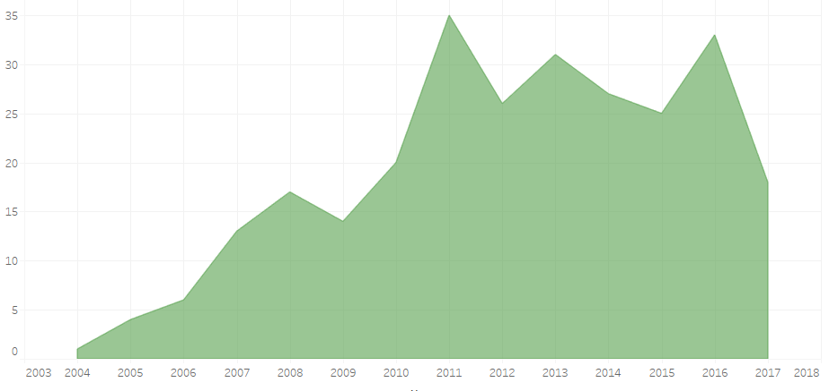
Year in which most number of cyber attacks took place.

Slide 6
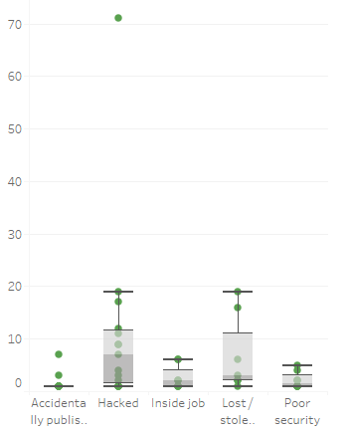
Major methods practiced to stole data.

Slide 7
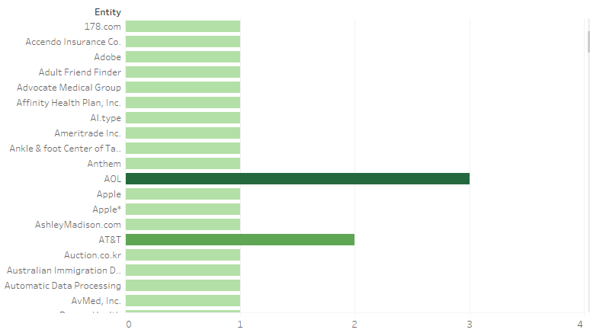
The main reason/ entity, through which data got breached.

Slide 8
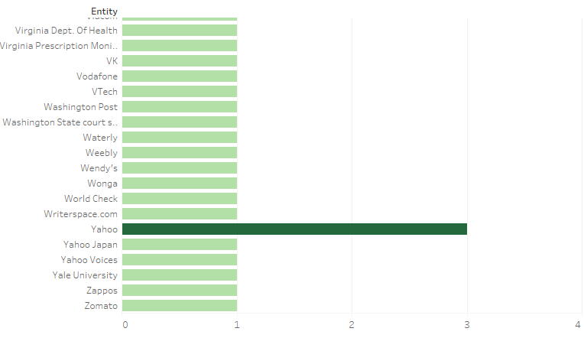

Slide 9
Visualization Dashboard

Slide 10
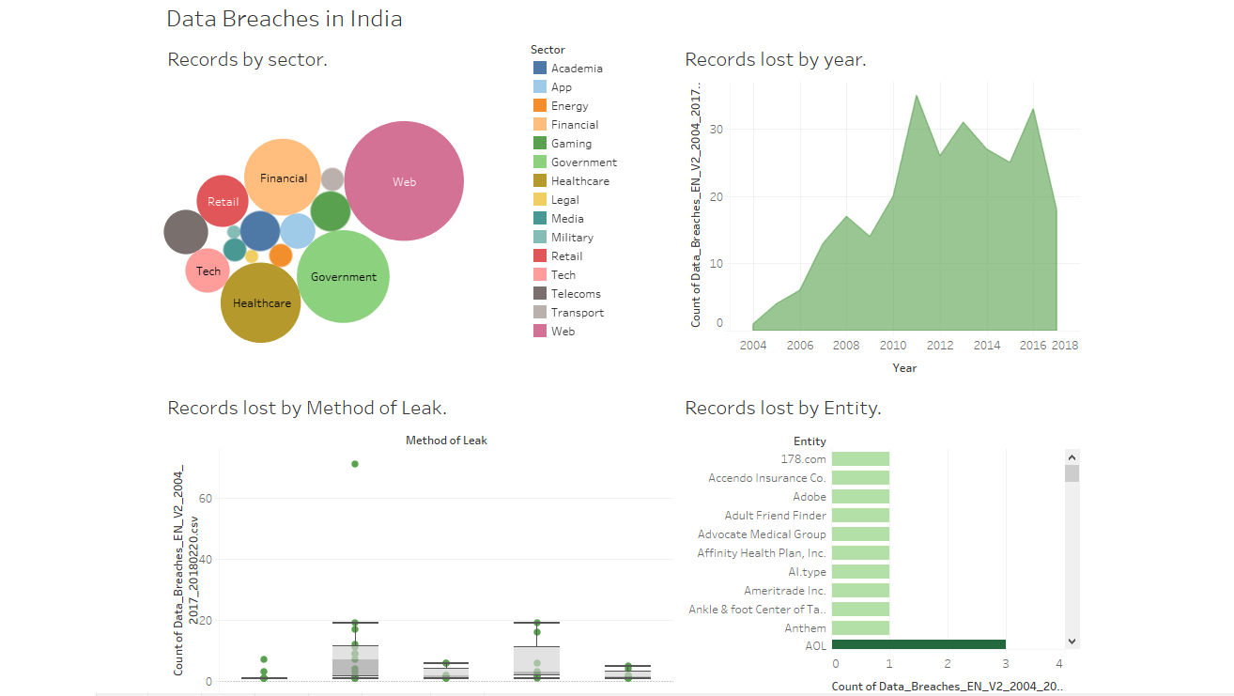

Slide 11
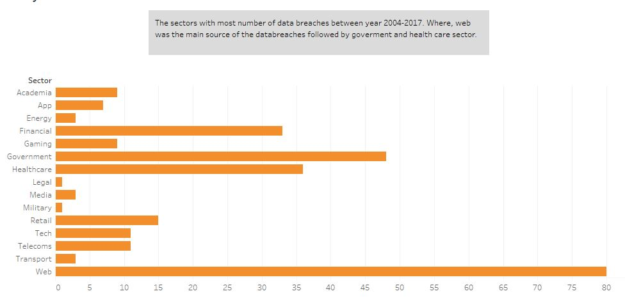
Story Creating
The below visualization shows the sectors with most number of data breaches between year 2004-2017. Where, web was the main source of the data breaches followed by government and healthcare sector.

Slide 12
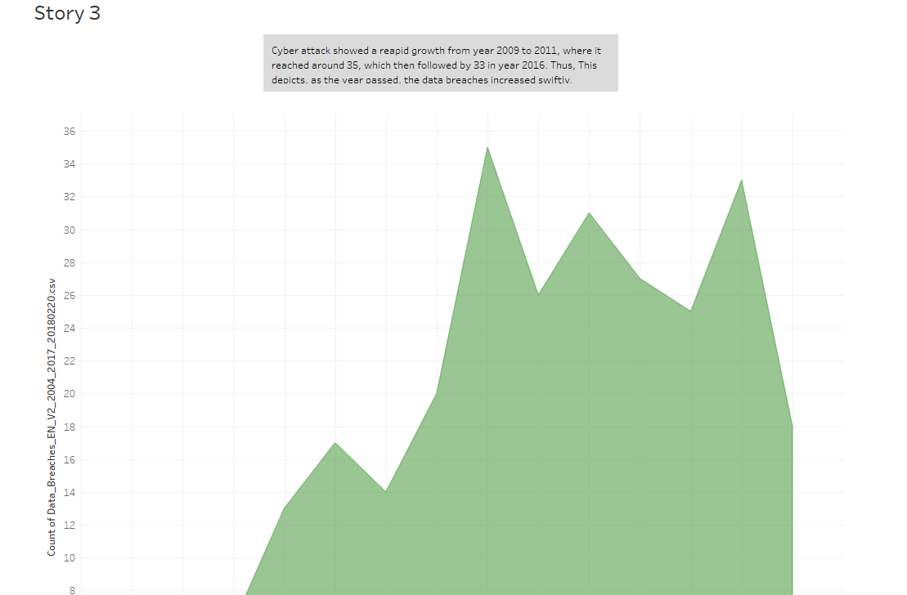
Most number of cyber attacks between year 2004-2017.
Cyber attack showed a rapid growth from year 2009 to 2011, where it reached around 35, which then followed by 33 in year 2016. Thus, This depicts, as the year passed, the data breaches increased swiftly.

Slide 13
Conclusion
The data breach visualizations performed on the data which was collected from year 2004 to 2017, showed a great impact, where these visualizations and interactive dashboard can lead to a successful conclusion of this project, where year 2010,2011 and 2017 were the years with the greatest number of cyber-attacks.
Moreover, visualizations performed to determine the main factor of method leak, where hacking and lost/stolen devices dominated. Lastly, many third-party sites or apps, were the key reason which lead to data breaches.
To conclude, the main agenda is to teach us to be aware of the fake messages as well as scam sites, so don’t directly click on it, and take precautions to keep your data safe.

Slide 14
Future Work
Will try to work on the live data in future, which would make a great impact on the public awareness on the data crimes.
Lastly, will try to make many more interactive dashboards, which would make the data more readable, or understandable.

Slide 15
THANK YOU

